Slide 1
Clinical Radiology
Can you see your
future in radiology?

Slide 2
What is clinical radiology?
Radiology is a cornerstone of diagnosis and treatment.
Radiologists are at the heart of patient care.
IMAGING
Diagnosis
Treatment
Multi-modality
Rapidly advancing
“An immense sea of knowledge, opportunity and research”
“I don’t think
I have ever found anything so challenging or rewarding.”
“Radiology offers so many opportunities for problem-solving”

Slide 3
Problem solvers required
There is an increasing dependence on imaging to diagnose.
Imaging is being used earlier and earlier in the diagnostic process.
Radiologists are key to early and accurate diagnosis.
Radiologists collaboratively solve clinical conundrums
Diagnosis

Slide 4
Radiology as treatment
Radiology is at the heart of patient care.
Increasingly treatments are image-guided.
Patient contact is increasing all the time – for example through:
  interventional radiology
  ultrasound sessions
  bone biopsies
  image-guided targeted treatment for cancer
  and more…
More than ever before radiologists are responsible for patient welfare.
Treatment

Slide 5
Variety and flexibility
Radiology encompasses an ever-increasing variety of techniques
  X-rays
  Fluoroscopy
  Computed Tomography (CT)
  Magnetic Resonance Imaging (MRI)
  Radionuclide (nuclear) radiology
  Ultrasound
  or a combination: PET-CT / PET-MRI
  Molecular imaging
Multi-modality

Slide 6
Always developing, always exciting
Clinical Radiology is one of the most rapidly advancing and technical specialties in medicine.
New frontiers:
Molecular and functional imaging
Quantification and automated image analysis
New image-guided treatments
Advancing technology:
Lower radiation doses
Faster acquisition times
Rapidly advancing

Slide 7
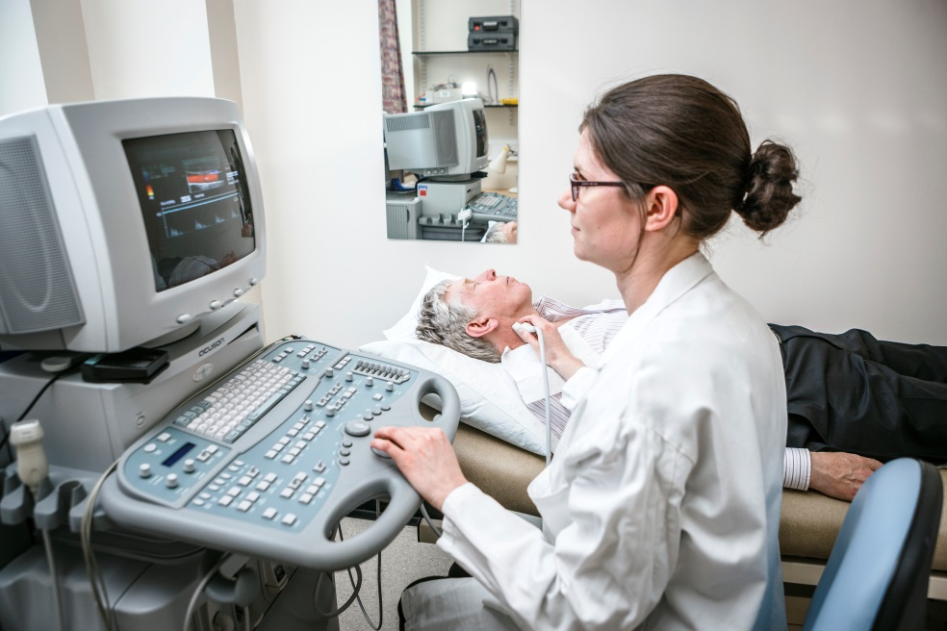
Why clinical radiology?
Be a problem solver
Central to patient care
Rapidly advancing
New techniques constantly being developed
Increasing dependence on imaging by the whole hospital
Challenging and innovative
General and specialist
A good work life balance
Common misconception: Radiologists spend all day, every day in a darkened room looking at a screen!
WE DON’T!

Slide 8

Does this sound like you?
Enjoy a puzzle? | ☑
Natural problem solver? | ☑
Keen eye for detail? | ☑
Want to be challenged? | ☑
Good communicator? | ☑
Want to be the hospital’s “go-to person”? | ☑
Enjoy being part of a team? | ☑
Have a good understanding of patient priorities and care? | ☑
IF THIS SOUNDS LIKE YOU,
BE A RADIOLOGIST!

Slide 9
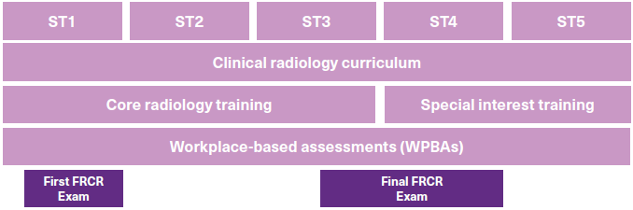
Structure of training
Clinical Radiology Training Pathway

Slide 10
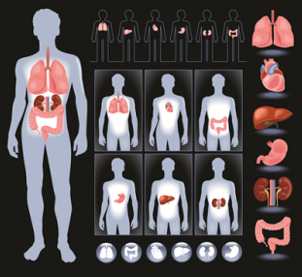
Do you want to specialise?
While Interventional Radiology is the only official sub-specialty of clinical radiology, there is a breadth of special interests allowing for specialisation.
Paediatric Radiology
Musculoskeletal
Vascular
Neuroradiology
Head and neck
Gastrointestinal
Oncology
Cardiac
Chest
Breast
Radionuclide Radiology

Slide 11
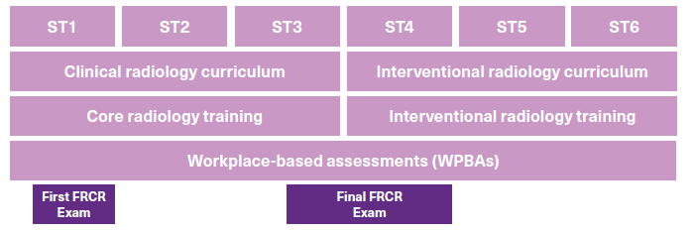
Interventional Radiology (IR)
The only official sub-specialty of clinical radiology.
IRs undertake a range of image-guided therapeutic procedures using the least invasive techniques.
Integral part of trauma teams and acute care giving life saving care
Wide variety
  Vascular
  Non-vascular
  Oncological
  GI
  MSK
IR training pathway

Slide 12
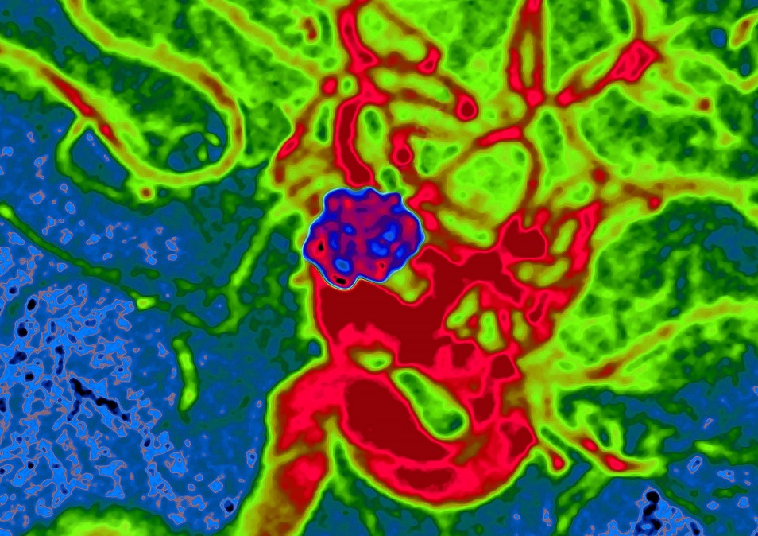
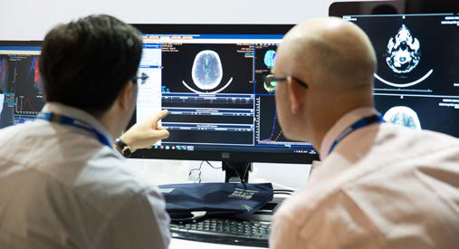
What do clinical radiologists have to say about their specialty?
“The radiology timetable is structured and varied and every day I see something new and interesting, which I’m not sure many other people can say about their specialties”
Dr Noor Jawad ST4
“As a growing and emerging specialty, radiology is in an entire world of its own, an immense sea of knowledge and opportunity”
Dr Omar Azmat- ST5

Slide 13
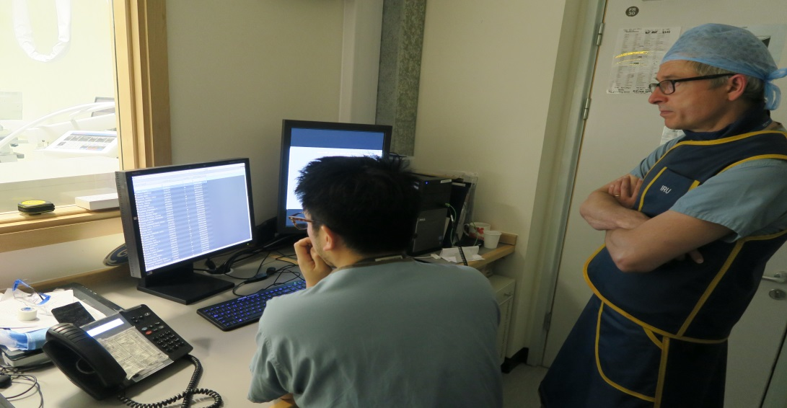
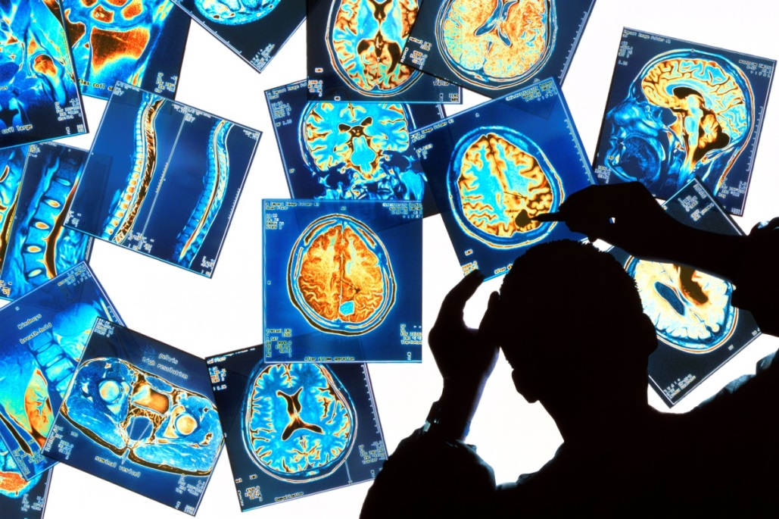
What do clinical radiologists have to say about their specialty?
“I’ve rarely met a clinical radiologist who doesn’t enjoy their work, and the sense of teamwork within the reporting room is a positive learning environment for everyone”
Dr Noor Jawad, ST4
“Clinical radiology provides trainees with the perfect mix of diagnostics and interventions. Offering flexibility based on clinical interests, radiology today is a far cry from the ‘sit in a dark room’ myth”
Dr Roma Patel, ST1

Slide 14
Training in XXXX Region
Insert information about your region e.g.
  rotation pattern, which teaching hospitals/DGHs do trainees work in
  OOP opportunities and support
  Flexible training opportunities
  Work/life balance
  Any particular facilities/expertise/technology that isn’t available everywhere (molecular imaging?)
  Local information – what’s great about the region
  Anything else you can think of

Slide 15
Interested? What to do next
Are you a medical student?
Apply for radiology undergraduate bursaries and prizes www.rcr.ac.uk
Look at the RCR’s Undergraduate Radiology Curriculum www.rcr.ac.uk
Choose a special study module or elective in clinical radiology
Develop your portfolio – conduct audits and research in imaging
Join an radiology society, or found your own. www.rcr.ac.uk/ursa
SPEAK to clinical radiologists
Sit in on reporting sessions and attend relevant MDTs

Slide 16
Interested? What to do next
Are you a junior doctor?
Consider an elective in radiology
Take part in a taster week or taster evening
Spend time in radiology departments, get to know the team
Speak to clinical radiology trainees and consultants
Undertake a portfolio of mainstream acute care clinical posts
Take or create any opportunity for radiological research or audit in an imaging topic

Slide 17
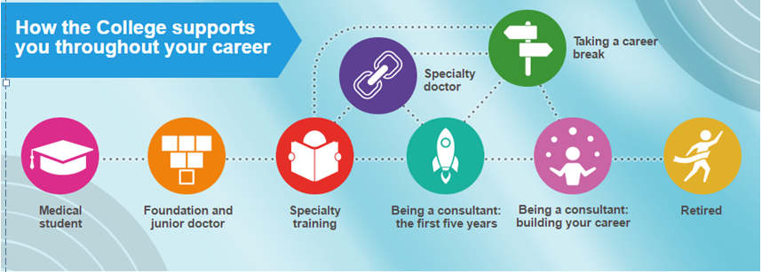
Interested?
Find out more about how the RCR can support you throughout your career as a clinical radiologist by visiting www.rcr.ac.uk/career-timeline

Slide 18
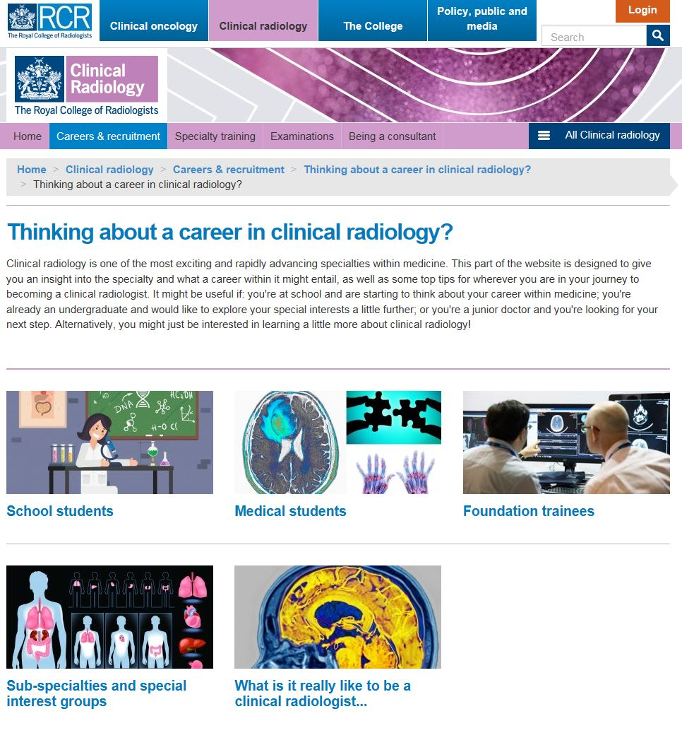
Want to know more?
Speak to local clinical radiology trainees and consultants
Go to the RCR website: www.rcr.ac.uk/radiology-careers

