Slide 1
Clinical Oncology
A career built on relationships

Slide 2
What is clinical oncology?
Clinical Oncology
Radiotherapy
Holistic Care
Research
Systemic therapy
Patient-centred
Team-work
“People who have a real mission for what they do”
“Intellectually stimulating and rewarding”
“The cutting edge of technology”
“We get to know our patients well”
“There’s no risk of getting bored”
“One of the most interesting and rapidly advancing areas of medicine”

Slide 3
Radiotherapy & Systemic Therapy
Radiotherapy
  Rapidly advancing technology
  Radical and palliative
  Hands-on practical skill
  Technical, scientifically diverse
Radiotherapy
Systemic Therapy
  Chemo, biological, immuno & hormone therapy
  New trials leading to personalised medicine and individualised treatment
Systemic therapy

Slide 4
Holistic and patient-centred
A holistic blend of all aspects of non-surgical cancer care
Be the patient’s advocate
  From diagnosis through to recovery or palliative care
Holistic care with patient contact in:
  clinics
  on the wards
  during treatments
Build relationships with compassion and empathy
Holistic care
Patient-centred

Slide 5
Team work
Be a key part of a multi-disciplinary team alongside:
  Radiotherapy & chemotherapy nurses
  Radiologists
  Radiographers
  Physicists
  Medical oncologists
  Surgeons
  Dosimetrists
  Palliative care physicians and nurses
Team work

Slide 6
Research
NHS funded exploratory research into rapidly advancing technologies such as proton beam therapy
Research opportunities in basic sciences, chemotherapy and patient experience
Go out of programme for:
  Fellowships
  Lab-based or clinical PhDs and MDs
Research

Slide 7
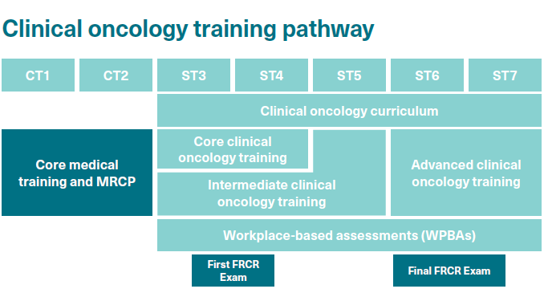
Training pathway

Slide 8
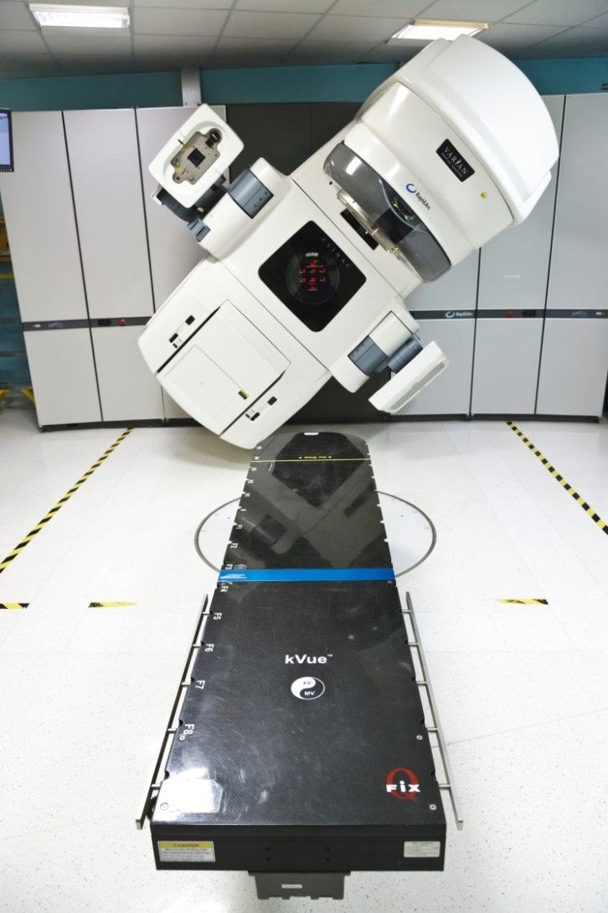
What do clinical oncologists have to say about their specialty?
“In over thirty years as a clinical oncologist, I have seen overall cancer cure rates soar from 25% to 50%. In the next thirty years they will surely reach 75%.”
Dr Seamus McAleer, Consultant
“Since starting as a registrar five years ago, every day has been different. Clinical oncology is intellectually stimulating and rewarding”
Dr Sam Cox ST6
“Compared to other specialities there are a relatively small number of clinical oncology registrars and so courses and conferences can be a friendly sociable occasion. This can be a useful way to network and share experiences.”
Dr Michael Kosmin ST5
“One of the most interesting and rapidly advancing areas of medicine”
Dr Philip Charlton ST4

Slide 9
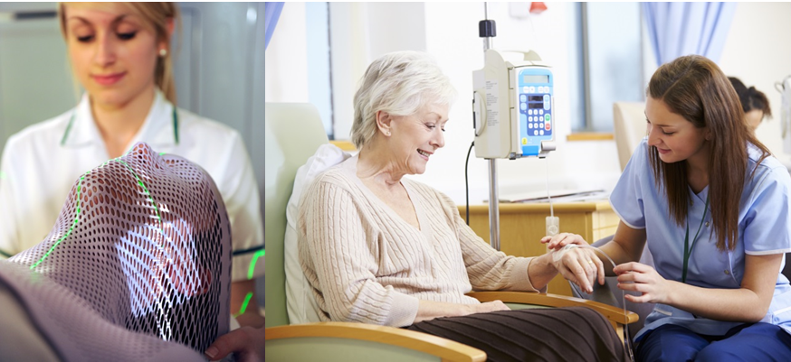
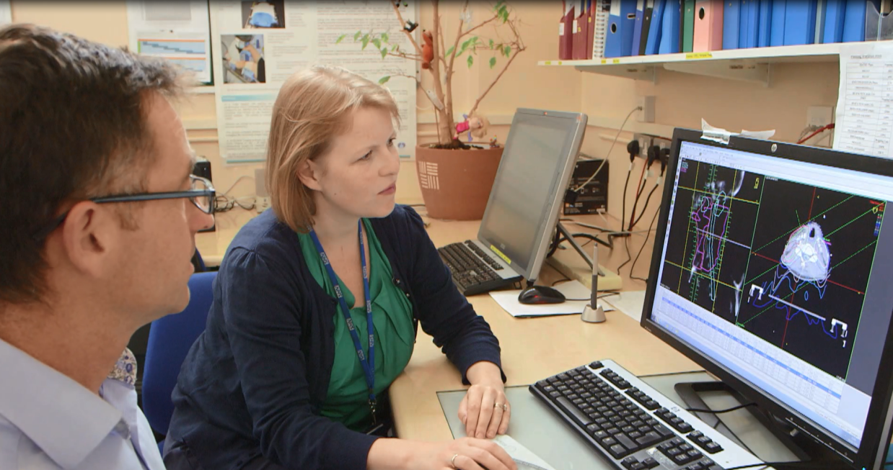
What do clinical oncologists have to say about their specialty?
“I am able to deliver optimised, individualised treatment options for my patients. As a clinician, I find this extremely satisfying.”
Dr Ganesh Radhakrishna, Consultant
“There’s no risk of getting bored”
Dr Georgina Casswell ST4
“Taking time out to do research is allowing me time within the training programme to pursue my interests, gain new skills and work more independently.”
Dr Sally Appleyard ST6

Slide 10
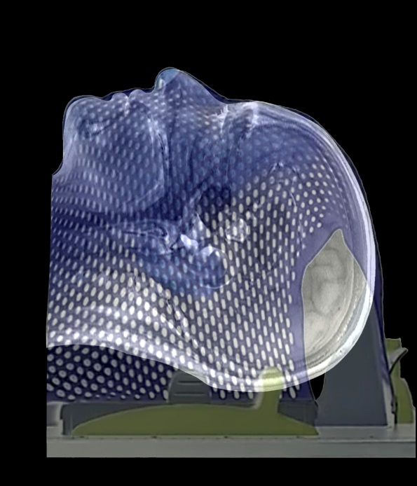
Interested? What to do next
Are you a medical student?
Apply for oncology undergraduate bursaries and prizes www.rcr.ac.uk
Choose a special study module or elective in clinical oncology
Develop your portfolio – conduct clinical or medical audits with an oncology focus
Join an oncology society, or found your own
SPEAK to clinical oncologists!
Spend some time finding out about how the
cancer services work in the UK

Slide 11
Interested? What to do next
Are you a junior doctor?
Gain a good grounding in general medicine
Take or create any opportunity for cancer related research
Do some clinical or medical audits
Spend time in oncology departments, get to know the team
Follow a patient through the radiotherapy process
Take part in a taster week or taster evening

Slide 12
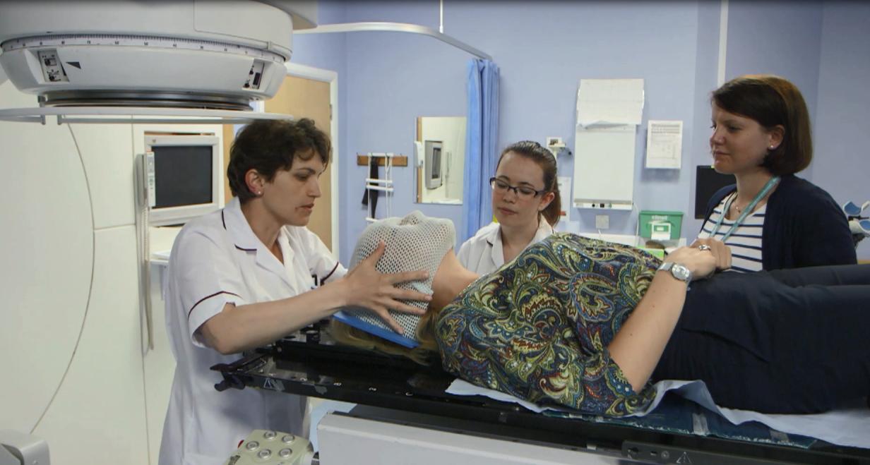
Interested?
“Get involved in taster weeks, keep your eyes open during your CMT training, cancer and chemotherapy are already very much part of your working lives.
You’ll be surprised at how much you already know.”
Dr Waleed Mohammed ST5

Slide 13
Training in XXXX Region
Insert information about your region e.g.
  rotation pattern, which cancer centres/DGHs do trainees work in
  OOP opportunities and support
  Flexible training opportunities
  Work/life balance
  Any particular facilities/expertise/technology that isn’t available everywhere (proton therapy?)
  Local information – what’s great about the region
  Anything else you can think of

Slide 14
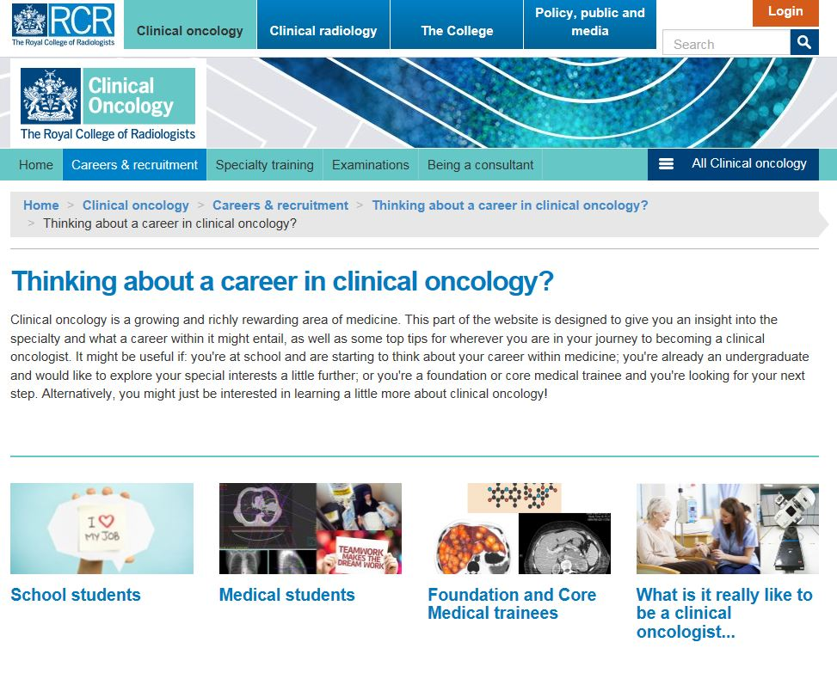
Want to know more?
Speak to local clinical oncology trainees and consultants
Go to the RCR website: www.rcr.ac.uk/clinical-oncology-careers

